Slide 1
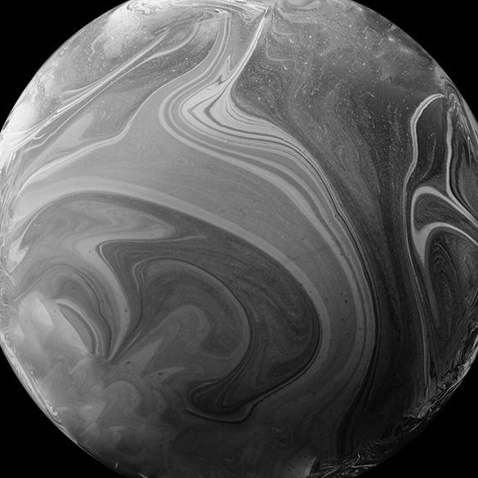
Space Mission Analysis
Course: Data Visualization Instructor: G. Atanesyan
Natela Azoyan, Lusine Adunts,
Liana Darbinyan, Hakob Nahapetyan

Slide 2
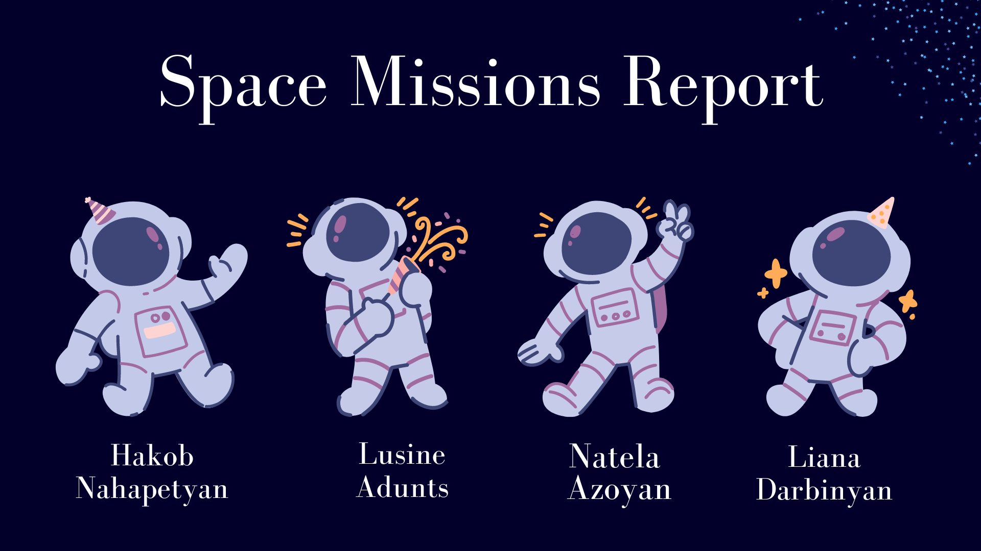
01
ANNOUNCEMENTS
You can enter a subtitle here if you need it

Slide 3
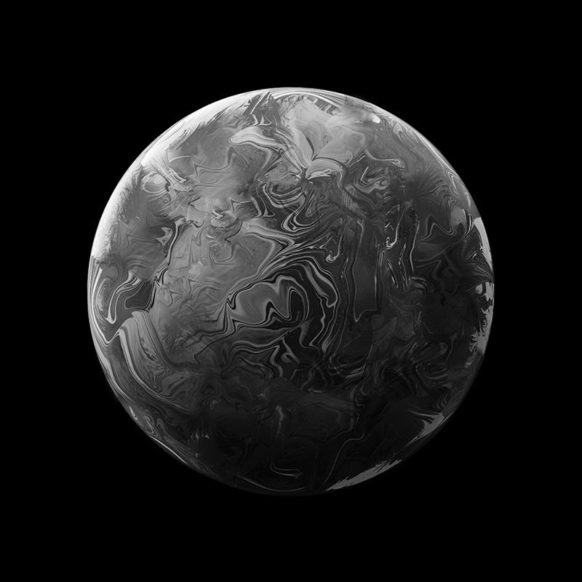
Introduction
Space exploration is the process of using technology and astronomy to explore the universe. It helps to accelerate scientific discoveries.
Although telescopes are widely used to investigate the space, the derived information is not enough.
To come to wider description of the outer space, humans have always been in interested in visiting the space physically, appearing on other planets and investigating the space in a smaller distance.

Slide 4
Methods
Data
Space missions
Corrected space missions
Astronauts
Tesla stock price
Code
Preprocessing in Python
Visualizations in R
Dashboard
RShiny

Slide 5

When was the First Space Mission done?
In 1957, October 4 when first artificial Earth satellite Sputnik 1 launched into Earth orbit.

Slide 6
01
Leader countries in Space Exploration are USSR/Russia, US

Slide 7
02
US and China are competing

Slide 8
03
Most popular Mission locations are either Russia or the US

Slide 9
04
The company that leads in the number of Missions is Nasa or SpaceX

Slide 10
05
The Day of the Mission Affects its Outcome

Slide 11
06
When There is a SpaceX Launch and It is Successful the Price of the Tesla Stock Goes Up

Slide 12
07
Women engage in Space Missions significantly less than Men

Slide 13
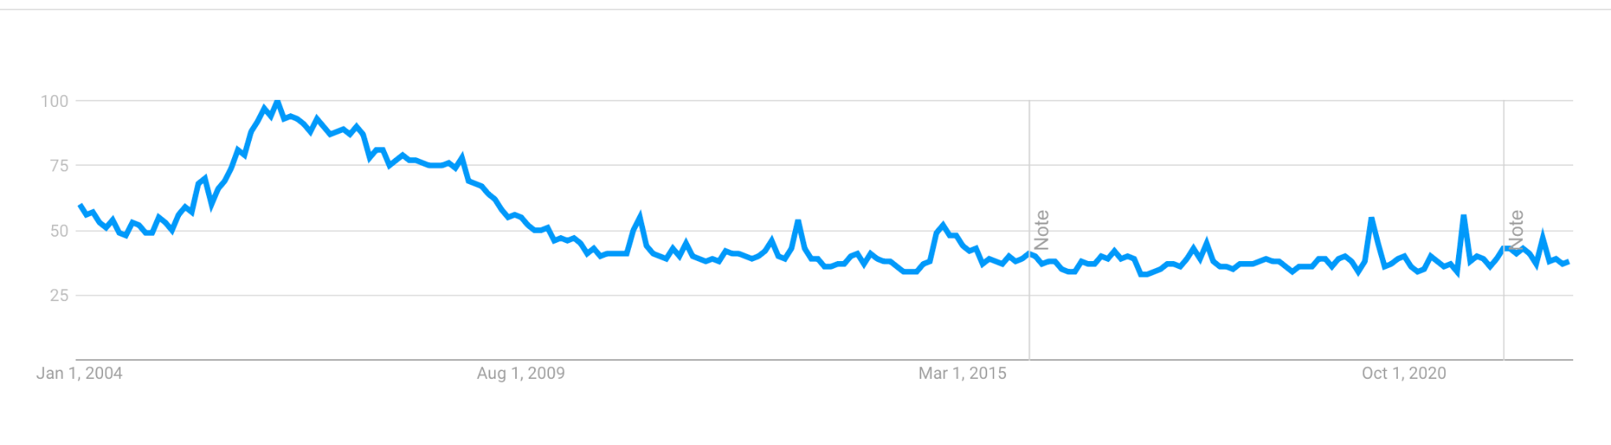
Interest over time
Popularity of the term ‘Space’

Slide 14
THANKS!

